Slide 1
Booking Ally
Nicholas Murray – A00255953

Slide 2

Introduction
The goal of my project was to identify a modern problem and to solve it using modern technologies that interest me.
Notes:
The main goal of my project was to develop a system using modern technologies and processes that could provide a potential solution to a modern problem.

Slide 3




Problem
With the current global pandemic a lot of services that wouldn’t normally have a need to take reservations now need to, such as barbers and retailers.
This has highlighted the fact that there is not many services available for companies to easily and uniformly take bookings.
Notes:
The problem I identified and decided to tackle is that there is no uniform or standard way for businesses to take reservations from there potential customers. Many companies resort to using various messenger services or in some cases making dedicated apps or websites, which do not get the traffic needed to justify their creation.

Slide 4

Opportunity
Create on online marketplace for businesses and tradesmen to advertise their services and take bookings from potential customers easily.
The ‘marketplace’ would tailor search results for a user dependent on their location and needs.
Notes:
The goal is to create an easy-to-use online service that would allow users to search for a particular service or business in their area and make a booking. The businesses could list their available services, availability and pricing.

Slide 5




System Overview
A platform that will allow businesses to advertise their services and availability via a website or mobile application.
The service will also allow businesses to take bookings from customers and allow for pre-payment of some services
Notes:
The aim of the system is to create a platform that will be easy to use by both the businesses and their customers.
Customers should be able to search for the type of service they require and view the available options in their area.
Once they find a business they like, they will be able to make a reservation at an available time and potentially pay for their services in advance.

Slide 6
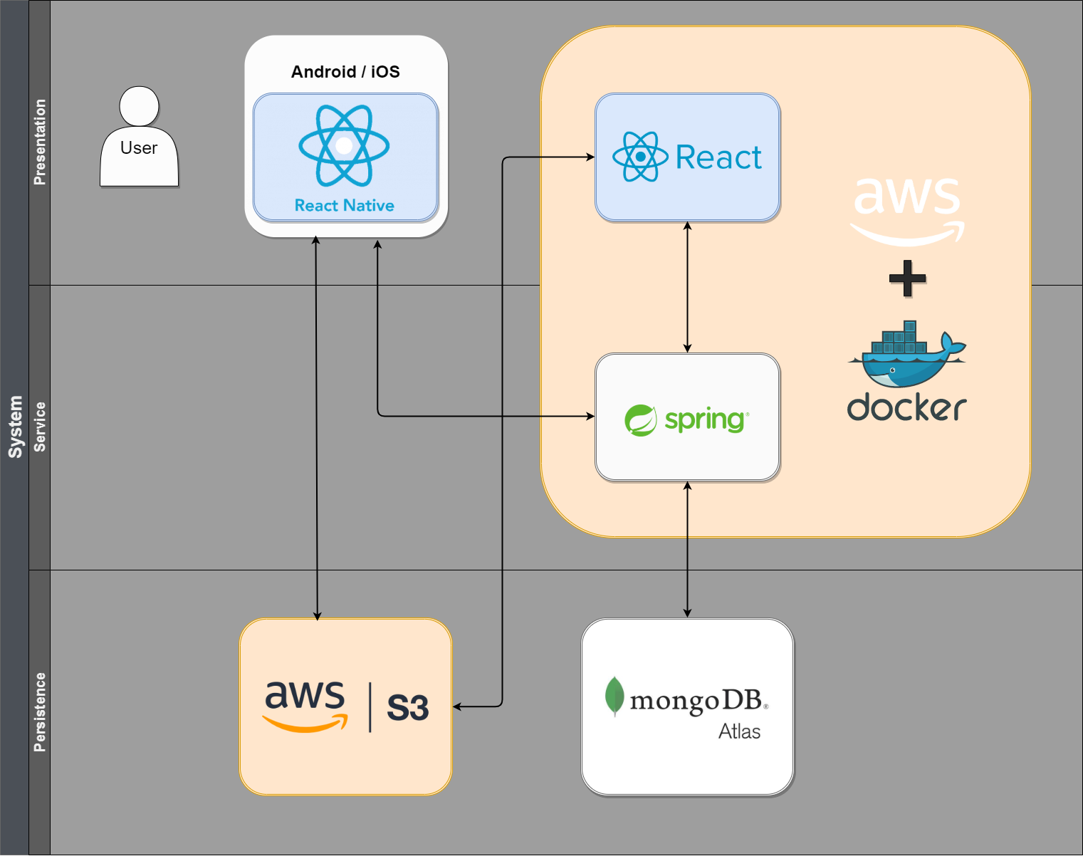
System Architecture
Notes:
I plan to use a layered architecture consisting of a Presentation, Service and Persistence layers.
My proposed architecture was originally going to be a typical model view controller architecture however the addition of amazon s3 for image storage meant that the model layer was no longer just the model but now it is a persistence layer.
Along with the layered architecture I have decided to use microservices, I wanted to use microservices so that I can easily incorporate a continuous integration and delivery system and to allow for much easier scalability and flexibility. And also the technologies behind them just interest me in general.
PRESENTATION:
The User will view the PRESENTATION layer with either the mobile app or the web client which will be run in a docker container on AWS.
The PRESENTATION layer requests data from the SERVICE layer which is the home to the REST service which is also running on AWS in a docker container.
The PRESENTATION layer can also request images from amazon s3 using the URLs received within the data from the SERVICE layer.
SERVICE:
The SERVICE layer is where the REST service is situated. The REST service contains multiple endpoints which can be used to carry out CRUD operations upon the collections in the database.
The service layer will be built using the spring boot framework.
PERSISTENCE:
The PERSISTENCE layer is home to the MongoDB database hosted on MongoDB atlas. The database will only communicate with the service layer.
The PERSISTENCE layer is also home to the amazon S3 storage bucket. This is currently contacted directly by the PRESENTATION layer to store and view images. However if the need arises to modify or edit the images before uploading them, the storage of the images may be moved to the service layer to take the processing load away from the client in the interest of speed.

Slide 7

Demo
Notes:
Demonstrate the CI/CD system using Github Actions and Dockerhub
Demonstrate how AWS ECS uses the Dockerhub images to create the containers

Slide 8
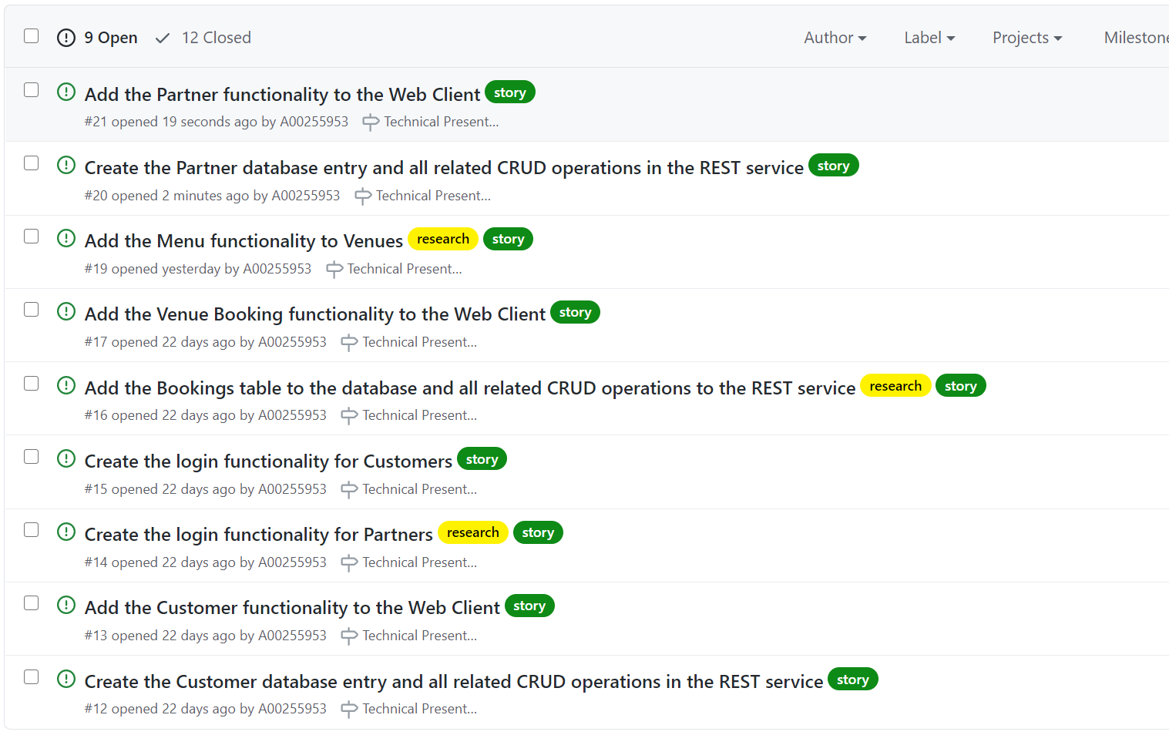
Future Requirements
Notes:
This is the list of current future requirements for the project,
The main requirement on here is the booking functionality which will allow users to actually create a booking for a service.

Slide 9
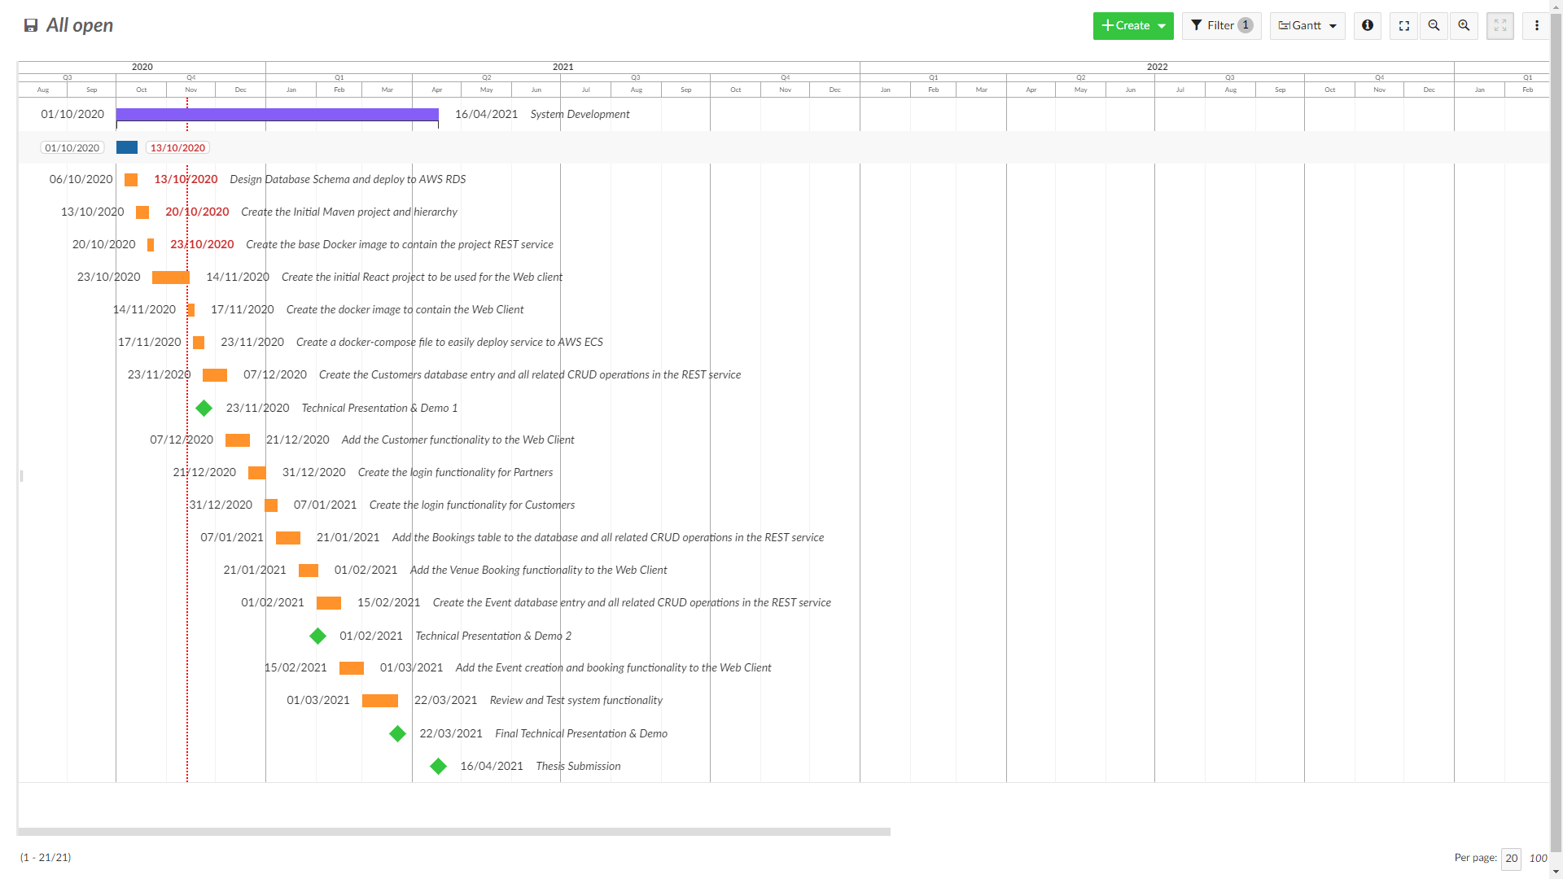
Timeline
Notes:
This is my project timeline, I have tried to split the requirements into three groupings based on the three project demos.
I done this because it was the clearest deadlines I could use to try put some structure into my plan

Slide 10

Questions…

